Slide 1
Image Processing
Pseudorandom Thresholding
Pseudorandom thresholding is an image halftoning method that created to solve the issue of false contours, which are created when using gray-level binary fonts. A matrix know as dither matrix is used, which can be calculated recursively if its size is a power of 2. Such a matrix contains integer elements, known as thresholds, that must be scaled before being applied to the image. Each pixel value is compared to an appropriate threshold (in an ordered manner) and depending on the result, it is set to either black or white.
For this exercise you are tasked to perform pseudorandom thresholding on a grayscale image.

Slide 2
Image Processing
Pseudorandom Thresholding
The algorithm takes as input a grayscale image and the size of the dither matrix which will include the thresholds that will be applied to the image. It then calculates the elements of the dither matrix and scales them to the range of [0, 255]. Afterwards, it compares each pixel value to an element of the dither matrix (a modulo operation is used in order to ensure that each element of the dither matrix is used in an orderly manner) and based on the result it changes the current pixel value to either 0 or 255.
Finally, it returns the halftoned image and displays it alongside the original one.

Slide 3
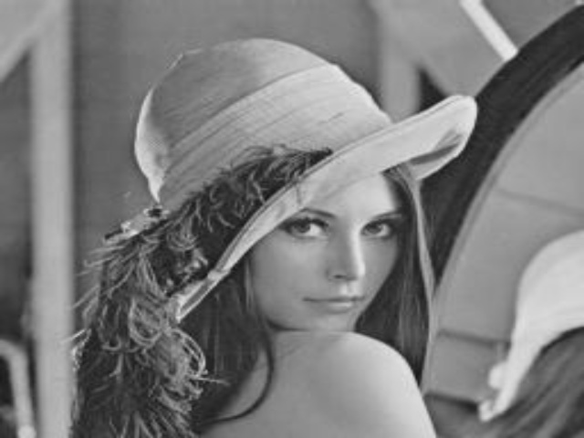
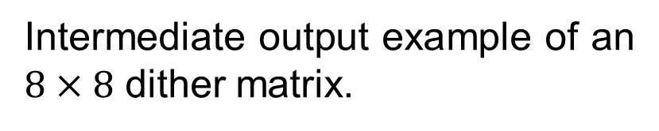
Image Processing
Pseudorandom Thresholding
Input example.
Intermediate output example of an $8×8$ dither matrix.

Slide 4
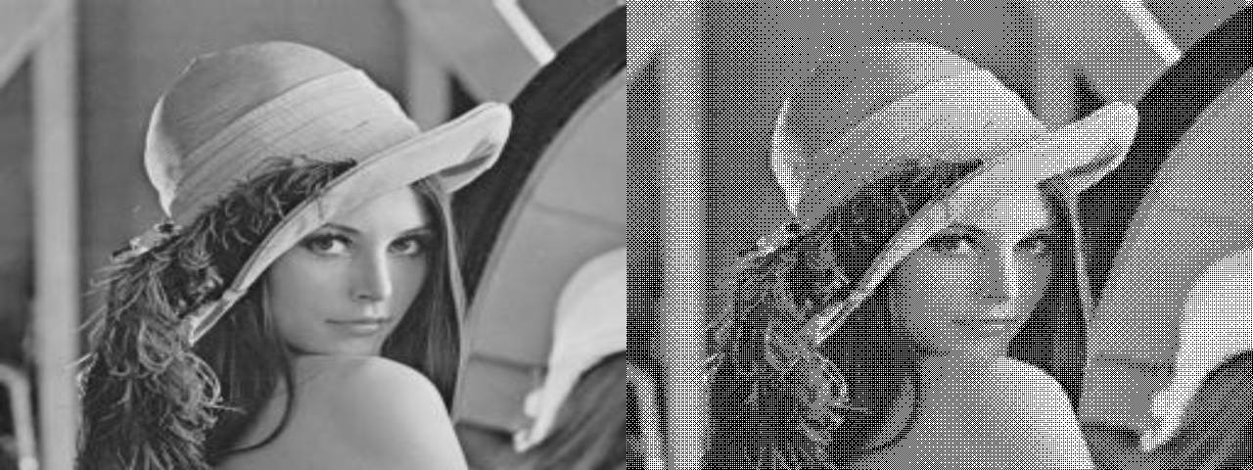
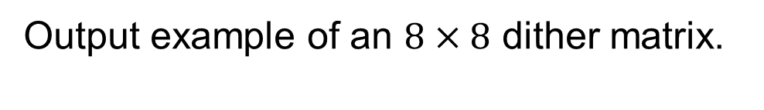
Image Processing
Pseudorandom Thresholding
Output example of an $8×8$ dither matrix.

